Slide 1
Lesson F What’s that ?
雅安市名山区实验小学 秦然

Slide 2
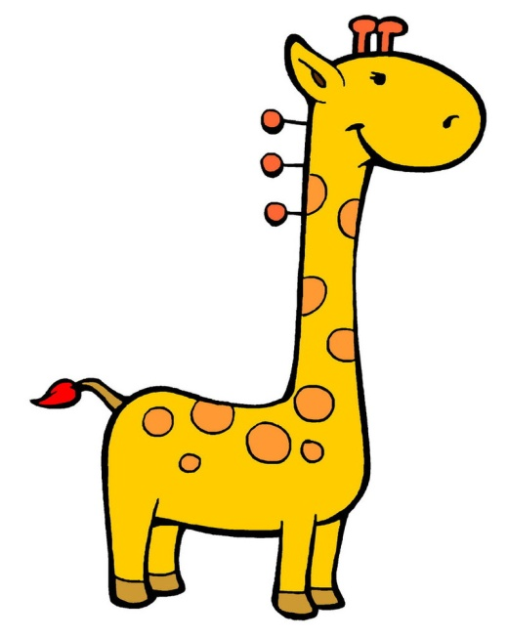
a
beautiful
picture
a
giraffe
an
ant
an
elephant

Slide 3
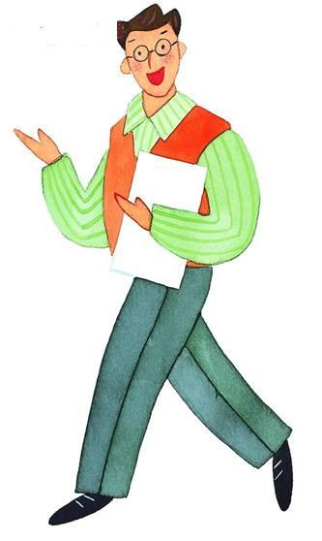
Lesson F What’s that ?
Wow! A beautiful picture!
What’s this?
What’s that?
It’s a rabbit.
It’s a bird.
Thank you very much.
Your English is good.

Slide 4
Thank you ! Bye-bye!
雅安市名山区实验小学 秦然

