Slide 1
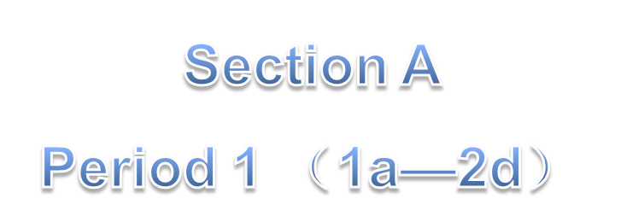
Unit 9
My favorite subject is science.

Slide 2
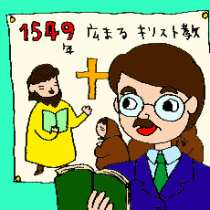
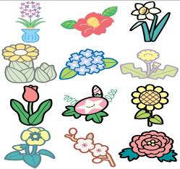
science
computer
subjects
biology(生物)
history (历史）

Slide 3
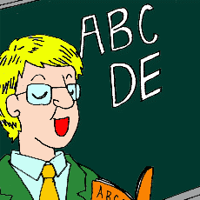
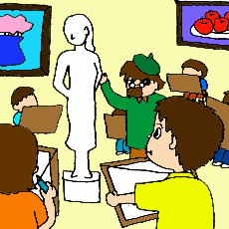
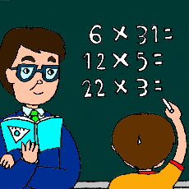
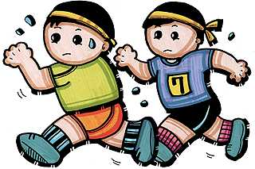
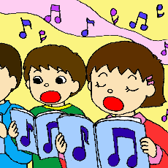
School Subjects
English
art
math
music
science
P.E.

Slide 4
语文 数学 英语
历史 生物
体育
音乐 美术 科学
Chinese
math
English
history
biology
physical education / P.E.
music
art
science

Slide 5
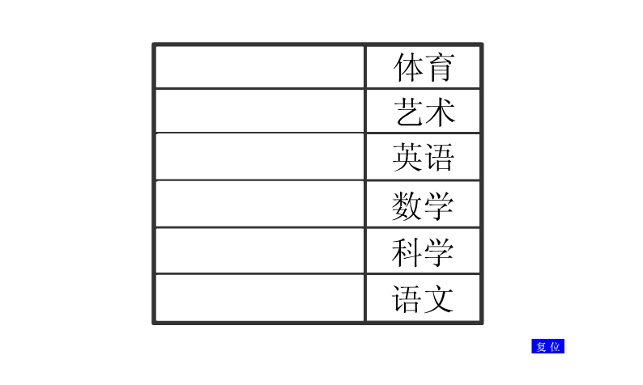
What subject do you learn at school?

Slide 6
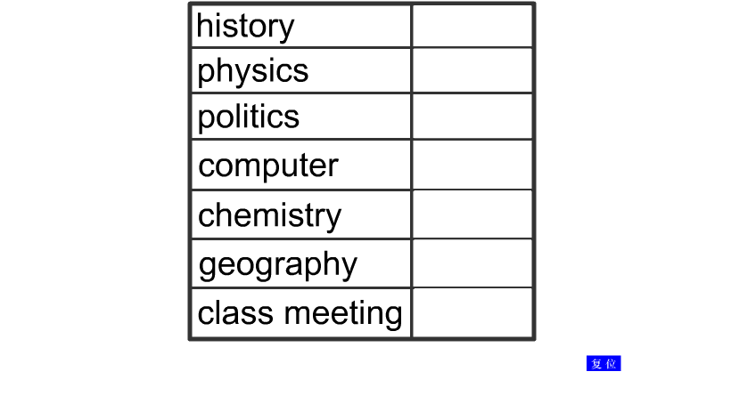
What subject do you learn at school?

Slide 7
1a
Match the words with the pictures.
c
1. P.E. ________
2. art ________
3. science ____
4. music ______
5. math ______
6. Chinese ____
7. geography ____
8. history _____
f
b
e
h
d
a
g

Slide 8
Listen and circle the subjects you hear in 1a.
1b
1. P.E.________
2. art ________
3. science ____
4. music ______
5. math ______
6. Chinese ____
7. geography __
8. history_____

Slide 9
What’s your favorite subject?
My favorite subject is science / music / English / math / Chinese / P.E. / art…

Slide 10
Listen and put the conversation in order.
2a
1
4
What’s your favorite subject?
Because it’s fun.
2
3
My favorite subject is P.E.
Why do you like P.E.?

Slide 11
Listen and match the subjects you hear with the descriptions.
2b
Subject
Description Word
art
science
music
P.E.
math
geography
history
fun
interesting
boring
difficult
relaxing

Slide 12
What’s your favorite subject?
My favorite subject is science / …
Why do you like science / …?
Because it’s interesting / …

Slide 13
2c
Pair work
What do you think of the subjects above? Make your own conversations using the words in 2b.
A: What is your favorite subject? B: My favorite subject is … A: Why do you like it? B: Because it’s …

Slide 14
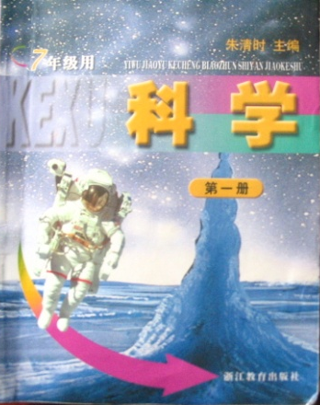
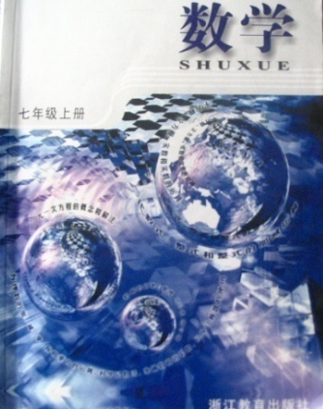
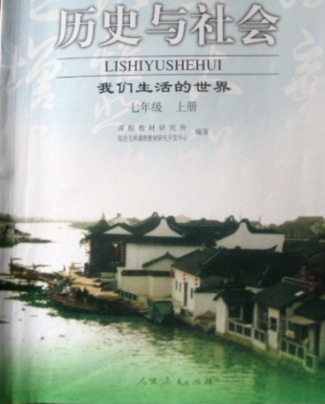
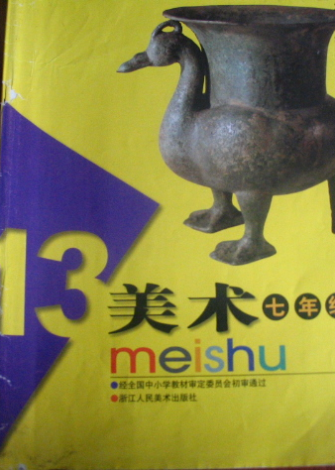
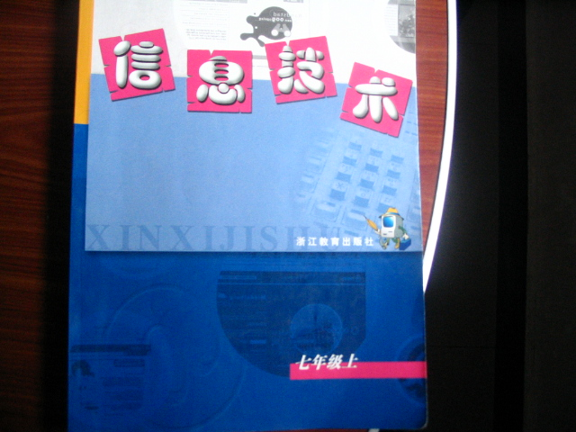
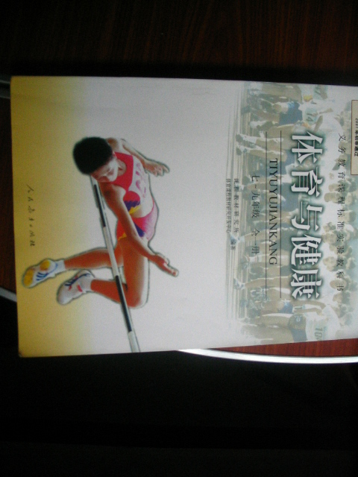
fun
useful
interesting
exciting
relaxing
important

Slide 15
I like English best.
—What’s your favorite subject?
—My favorite subject is English.
—Why do you like English?
—Because it’s useful and interesting.

Slide 16
I like music best.
—What’s your favorite subject ?
—My favorite subject is music.
—Why do you like music?
—Because it’s relaxing.

Slide 17
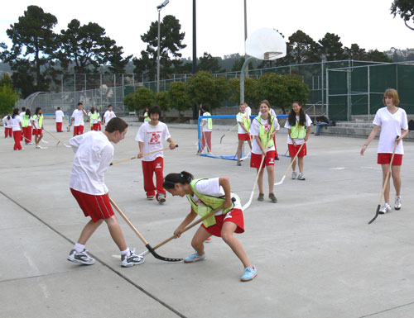
I like P.E. best.
—What’s your favorite subject ?
—My favorite subject is P.E..
—Why do you like P.E.?
—Because it’s fun.

Slide 18
2d
Role-play the conversation.
Why does Bob like Monday?
Who is Bob’s P.E. teacher?
Because he has P.E. and history on Monday.
Mr. Hu.

Slide 19
Frank: Hi, Bob. How's your day?
Bob: It's OK. I like Monday because I have P.E.
and history. They are my favorite subjects.
Frank: who's your P.E. teacher?
Bob: Mr. Hu. He always plays games with us.
Frank:That's great ! But why do you like history?
It's boring.
Bob: Oh, I think history is interesting. What's
your favorite day?
Frank: Friday.
Bob: Why?
Frank: Because the next day is Saturday!
Bob: Haha! That's for sure. I like Friday, too.

Slide 20
because conj. 因为
He doesn’t go to school because he is ill.
他因病没去上学。
He will sell his house because he needs money.
因为缺钱，他将出售他的房子。

Slide 21
because的用法：
1. because 表示的原因是必然的因果关
系，语气较强，通常放在主句之后，若
需强调则放在主句之前。
2. 通常用来回答 why提出的问题。如：
--- Why can’t you do it now?
你为什么不现在就做呢?
--- Because I’m too busy.
因为我太忙。

Slide 22
for sure 肯定，一定 ；确实如此，毫无
疑问
No one knows for sure what happened to Bill.
没有人确切知道比尔出了什么事。
She won't dare do that again, and that's for sure.
她不敢再干那事了，那是毫无疑问的。
I think he lives there but I couldn't say for sure. 我想他是住在那里的，但我不敢肯定。

Slide 23
Homework
Do the other exercises in this part.

