Slide 1
Unit 3
English Around the World
Topic 2
Some things usually have different meanings in different cultures.
Section C

Slide 2
阅读目的
1.让学生掌握基本的词汇和相应的知识点
2.通过学习让学生了解东西方的文化差别
3锻炼善于用英语表达描述周围的事物

Slide 3
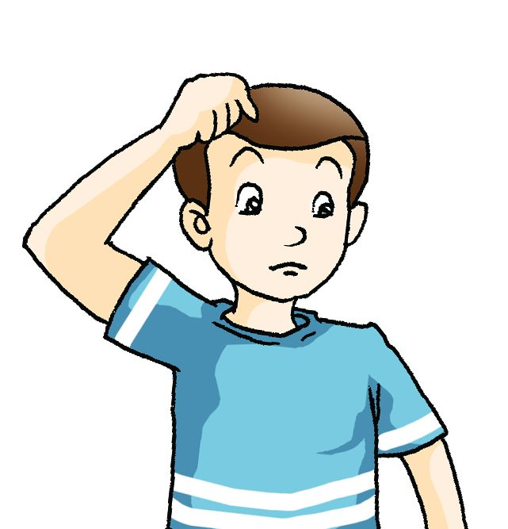
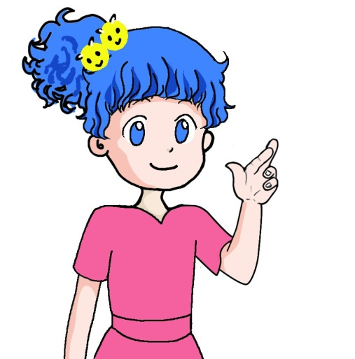
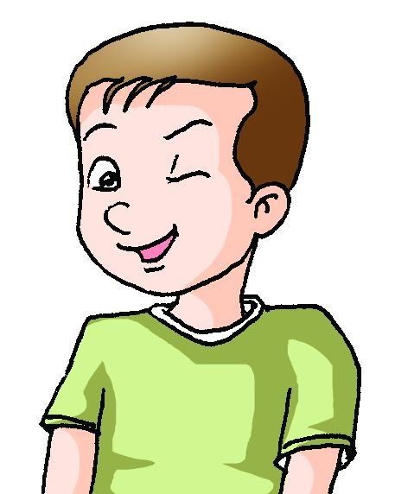
What do the gestures that are common in the USA mean? (读前活动)
I’m puzzled.
Good luck.
I’m just kidding.

Slide 4
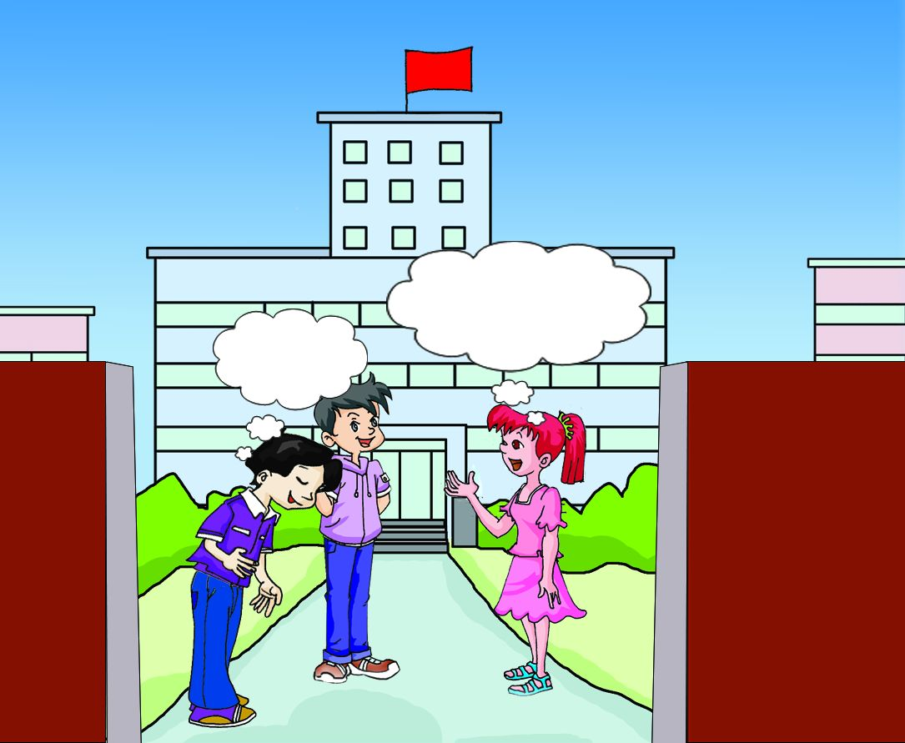
wave hands
In Canada, people ______________ when they greet each other, while people_____ as a sign of ________ in Japan.
bow
wave their hands
bow
respect

Slide 5
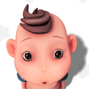
In Canada, nodding head shows ______________,while people ____________________________ to show agreement in India.
agreement
shake their heads from side to side
Body language means different things in different cultures.

Slide 6
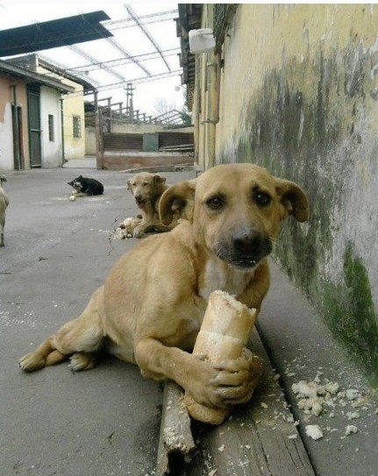
Look at these pictures

Slide 7
1b Read 1a and choose the correct answers.
（读中活动）
Fast Reading
C
The title of the passage may be ____.
A. Animals and Plants B. China and Foreign Countries
C. Different Cultures, Different Meanings D. Positive and Negative Meanings
2. In China, many parents want their children to become “dragons”. The “dragons” here mean ____ .
A. successful people B. children
C. strong people D. creatures
In western countries, heroes killed dragons to protect people. This shows dragons are considered to be ____ .
A. brave B. strong C. lovely D. dangerous
4. In Paragraph 3, the underlined word “regarded” means ____ .
A. considered B. given C. looked D. watched
A
D
A

Slide 8
Careful Reading
Read Para.2 carefully and guess the meaning of each phrase about dogs in pairs.
in China
in western countries
a homeless dog
a mad dog
a running dog
a dog catching a mouse
You are a lucky dog.
Every dog has its day.
You are a lucky person.你真是个幸运儿
Each person has good luck at times. 人人都有得意日。
丧家狗
疯狗
走狗
狗捉耗子多管闲事
Dogs are considered honest and good friends of humans.

Slide 9
Careful Reading
Read Para.3 carefully and mark T (true) or F (false).
( )1. Dragons play an important role in Chinese
culture.
( )2. In ancient times, the Chinese emperors
compared themselves to dragons.
( )3. In western cultures, dragon has positive
meanings.
T
n.皇帝
T
F

Slide 10
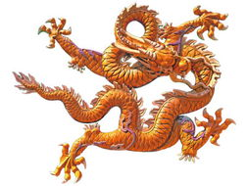
Language point
The ancient emperors compared themselves to dragons.
古代的皇帝把自己比作龙。
compare…to…
把……比作……
compare…with…
e.g.
把……和…… 作比较
(1)他在诗中把那姑娘比喻成月亮。
He ________ the girl ____ the moon in the poem.
(2)如果把他俩的工作作比较，你就会发现她的好很多。
If you ______________________, you’ll find hers
is much better.
compared
to
compare her work with his

Slide 11
Careful Reading
Read Para.4 carefully and choose the right answers.
( )1. Rose ____ in Chinese culture and western
cultures.
A. has similar meanings
B. has different meanings
C. has negative meanings
( )2. Rose stands for the following except ____ .
A. love B. peace C. good luck D. courage
A
C
n. 勇气

Slide 12
Retell the text based on the table you filled in.
1c Complete the table based on 1a. You can also add something else.
Plant and animal | In Chinese culture | In western culture
dog
dragon
rose
honest, and good friends of humans; has positive meanings
negative meanings
strong and magical creatures
dangerous animals
stands for love, peace, courage and friendship
stands for love, peace, courage and friendship

Slide 13
Listen, read and find the following phrases in the passage.
consider the dog honest
at times
be regarded/ considered as
compare…to
a symbol of
stand for
pay attention to
有时；间或
被当做/认为……
认为狗诚实
……的象征
注意
代表
把……比喻成……

Slide 14
Complete the sentences with the correct forms of the given phrases.
pay attention to stand for at times regard as compare…to
People say the rose often ___________ love.
Dogs are ____________ honest and good friends of humans.
You need to _________________ the differences more.
Robert Burns __________ his love ______ a red rose.
Everybody makes mistakes _________.
stands for
regarded as
pay attention to
compares
to
at times

Slide 15
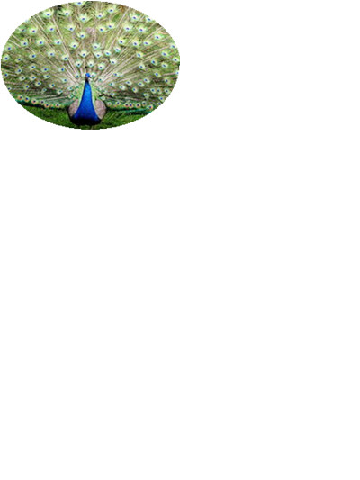
Write a passage with the title Different Cultures, Different Meanings based on the table. You can add more items.（读后活动）
Plant and animal | In Chinese culture | In western culture
peacock | goodness/ beauty/peace | pride
bat | long life/ happiness | bad luck
bamboo | happiness/ peace | wisdom/ power
…

Slide 16
How to write your composition
Discuss in groups to get the fact and supporting ideas.
Draw your draft.
The phrases in 1b may help you!
stand for, regard/consider…as, a symbol of, have positive/negative meaning…
Compose your writing.
but, while, however
Don’t forget the conj.
Check your spelling, tense etc.

Slide 17
One possible version:
Some things usually have different meanings in different cultures. Here are some things that have different meanings between the Chinese and western cultures.
In China, peacock is a beautiful animal that stands for beauty and goodness. Bats also have positive meanings in China, especially in the southern part of the country. They stand for life and happiness. However, for people in western cultures, they mean bad luck. Bamboo is a symbol of happiness and peace in China, but it means wisdom and power in western cultures.

Slide 18
Exercises
Dragon _______________(被当做）the symbol of Chinese nation.
If you ___________________(多注意）what the teacher says in class, you will not ____________________ (犯相同的错误）.
We usually _____________ life _______ stage.(把…比作).
Bamboo _______________（代表）wisdom and power in Chinese culture.
I usually go to the movies with my parents, but ________ alone（有时）.
My sister ___________ (leave) for Paris in a few days.
is considered as
pay more attention to
make the same mistake
compare
to
stands for
at times
is leaving

Slide 19
Summary:
We learn:
Some words: negative, consider, honest
positive, ancient, magical, creature,
compare, courage, underline, pride
2. Some phrases: at times, stand for,
regard/consider…as,
a symbol of, make mistake,
compare…to, compare…with
3. Some sentences:
(1)The ancient emperors compared themselves to dragons.
(2)The rose is regarded as a symbol of love.
We can:
Tell the culture differences between China and western
countries.
2. Write a composition about the different cultures of the same thing.

Slide 20
Assignment
Read 1a.
Memorize the useful expressions and key sentences which we learn today.
Finish Section C in your workbook.
Review Sections A-C.

Slide 21
Thank you!

