Slide 1
Unit 5
Do you want to watch
a game show?

Slide 2
中央电视台新闻
晚间新闻
世界报道
天气预报
体育新闻
实话实说
肥皂剧
人与自然
情景喜剧
CCTV News
Evening Report
World’s Report
Weather Report
Sports News
Tell it like it is
Soap Opera
Man and Nature
Sitcom

Slide 3
What do you think of game shows?
I love them.

Slide 4
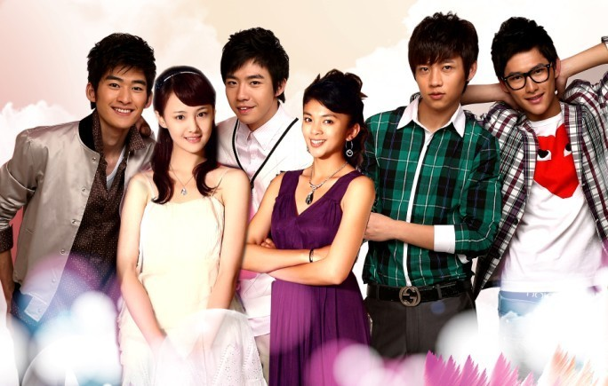
soap operas
What do you think of soap operas?
I don't like them.

Slide 5
action movie
romance
comedy
movies
cartoon
documentary
thriller
Science-fiction
interesting, exciting, funny, scary, sweet,
instructive, relaxing , great, boring, sad

Slide 6
Why do you like action movies?
Because I think they are exciting.
Who is your favorite actor?
My favorite actor is Jet LI.
Which movie do you like best?
I like Shaolin temple best. It's a successful action movie.

Slide 7
can’t stand
无法忍受
can’t stand sth.
He can’t stand hot weather.
can’t stand doing sth.
He can’t stand staying at home.

Slide 8
Language Points
2. I don’t mind them. 我不介意他们。
mind: 介意; 在乎; 反对。
①其后接名词或v-ing，常用于疑问句Would
you mind doing …? 或Do you mind …?
表示请求或征求意见。
② mind doing sth.介意做某事
mind one’s doing sth
介意某人做某事

Slide 9
Translation
I don’t mind them.
我不介意他们。
Would you mind opening the door?
你介意把门打开吗？
Do you mind my smoking ?
你介意我吸烟吗？

Slide 10
一 动词不定式做宾语
1. 动词不定式的形式：to + 动词原形
2. 常见的跟动词不定式做宾语的动词有:
want, ask, decide,expect, forget, hope, learn, wish, would like等。如：
We hope to get there before dark.
我们希望天黑以前到那儿。
The girl decided to do it herself.
那个姑娘决定自己做那件事。

Slide 11
动词不定式作宾语的注意事项
1．有些动词既可跟不定式作宾语，也可跟动名词作宾语，但含义不同：
remember to do 记住要做某事；remember doing 记得曾经做过某事
forget to do忘记要做某事
forget doing 忘记曾经做过某事

Slide 12
stop to do 停下来去做某事
stop doing 停止做某事
go on to do 继续做另一件事
go on doing 继续做原来在做的事
I remember seeing you somewhere before.
我记得以前在哪儿见过你。
Please remember to turn off the light when you leave.
离开时请记得关好灯。

Slide 13
二 动词不定式做宾语补足语
1．后面能接to不定式作宾语补足语的动词有：ask, order, teach, tell, want, wish, help等。
句型：ask sb to do sth.
The teacher told us to do Exercise 1.
老师要我们做练习一。

Slide 14
2．使役动词let, have, make及感官动词see, watch, notice, hear, feel等要以不带to的不定式作宾补。
Let’s have a rest. 我们休息一会吧。
I saw him come in. 我看见他进来了。

Slide 15
3.注意：感官动词后既可跟不带to的不定式作宾补，也可跟v-ing作宾补，前者表示动作的全部过程已结束；后者表示动作正在进行。
I saw him come downstairs.我看见他下了楼。（说明他下楼了这件事）
I saw him coming downstairs.我看见他正在下楼。（说明他下楼时的情景）

Slide 16
三 动词不定式的否定形式
动词不定式的否定式是在to前加not；不带to的不定式则在动词前加not. 如：
句型：ask sb not to do sth.
let sb not do sth.
Zhang Ming asked me not to stay at home all day.
张明要我不要整天呆在家里。
My mother let me not do it by myself.
妈妈让我不要独自做这件事。

Slide 17
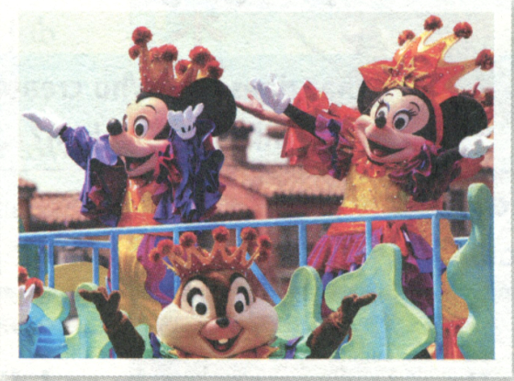
2b Read the passage and complete the time
line on the next page.
When people say “culture”, we
think of art and history. But one
very famous symbol in American
culture is a cartoon. We all know
and love the black mouse with two large round ears-Mickey Mouse. Over 80 years ago, he first appeared in the cartoon Steamboat Willie.

Slide 18
Language points
I like to find out what different people think
about a subject.
我想找出不同人对同一个主题的看法。
“ find out” 表达找出答案，弄明真相，查明情况等意思。如：
Please find out when the train leaves.
请查一下火车什么时候离站。

Slide 19
表示“寻找，找出”等近义词还有“ look for , find”
1）look for “寻找”指有目的地找。强调“寻找”
的过程。
e.g. What are you looking for?
你在找什么？ （强调找的过程）
2) find vt. “找” 强调找的结果。
e.g. I looked for my book everywhere, but I
didn’t find it. (结果是没找到）

Slide 20
2. What is your favorite cartoon?
你最喜欢的卡通片是什么？
“ what’ s your favorite…? 其同义句为
“ what… do you like best?
回答用: My favorite book is …
或 I like …best.
e.g. --what’s your favorite book?
= what book do you like best?
-- My favorite book is Snow White.
或是 I like Snow White best.

Slide 21
3. When people say “culture”, we think of
art and history. 当人们提起文化时，我们就 会想到艺术和历史。
think of 考虑；认为；想起；
例如：
Does the poem make you think of spring?
这首诗有没有让你想到春天？
How many stars can you think of?
你能想到多少明星？

Slide 22
4. When this cartoon came out in New York on
November 18, 1928, it was the first cartoon
with sound and music.
当这部动画片于1928 年11月18 问世于纽约
时，它成为第一部带有音乐的动画片。
“ come out” 在本句中译为“ 出版” 引申为
“ 问世”。此外还有：出来，（花）开出来之意。
e.g. The book comes out this week.
该书本周上市。
Oh, look! The sun's coming out!
噢，看！太阳出来啦！

Slide 23
5. One of the main reasons is that Mickey was
like a common man, but he always tried to
face any danger.
一个主要原因是米奇看似一个普通人，但
他总是尝试应对任何危险。
one of …后跟可数名词复数，表示…之一。
其后的谓语动词用单数。
e.g. One of my favorite movies is Mr. Bean.
我最喜欢的电影之一是憨豆先生。
One of my best friends is Ann.
安是我最好的朋友之一。

Slide 24
6. However, he was always ready to try his best.
然而， 他总是做好尽全力的准备。
1) be ready to do sth 准备做某事
get ready to do sth 与之同义，但前者强
调状态，后者强调动作。
e.g. Are you ready to start? 你准备好了吗？
Please get ready to start.
请作好开始的准备。

Slide 25
2) Try one’s best 尽某人最大的努力
其后跟动词不定式形式，即：
try one’s best to do sth.
e.g. Don't give up. Just try your best.
不要放弃。只管尽你最大的努力。
Come on！Just try your best to let your
dream come true.
加油！尽最大的努力去实现你的梦想吧。

Slide 26
7. People went to the cinema to see the “little man” win.
人们去电影院是为了看这个“ 小人儿” 赢。
go to the cinema 也可译为“ 看电影”类似
表达如下：
go to movies
go to a movie
go to see a movie.

Slide 27
8. Today’s cartoons are usually not so simple as little Mickey Mouse.
现在的卡通片通常不像米老鼠那样简单。
此句中not so… as 结构表示“ 不如……”。又如：
It wasn’t so good as last time.
这次不如上次好。

Slide 28
.
1. 想起 __________
2. 例如 ________
3. 发行; 出版 ___________
4. 在二十世纪三十年代 _____________
5. 主要原因之一 ______________________
6. 努力做某事 ______________
7. 准备好做某事 __________________
8. 尽最大努力 _____________
think of
such as
come out
in the 1930s
one of the main reasons
try to do sth.
be/get ready to do sth.
try one’s best （ to do )

Slide 29
9. She dresses up like a boy and takes her
father’s place to fight in the army.
她女扮男装，替父上战场打仗。
1） dress up “盛装打扮、乔装打扮”。
e.g. I’d like you to dress up for my birthday
party tonight.
今晚我希望你为我的生日派对打扮打扮。
Young kids often dress up and have fun
at Halloween. 万圣节前夜，小孩子通常都
乔装打扮，玩得很开心。

Slide 30
2）take one’s place 取代某人的位置，顶替。
e.g.
A robot will take his place.
一名机器人将代替他的位置。
Zhu Bajie believes that no one can take
Sun Wukong's place in his heart.
猪八戒坚信没有人能取代孙悟空在他心中的位置。

Slide 31
10. They did a good job in the movie.
他们在电影中表演出色。
do a good job 干得好; 干得出色
e.g. I'm sure you can do a better job next time.
我相信你下次会干得更好。
You've done a good job of it.
你干得太漂亮了!

Slide 32
三．单项选择
1. What do you ________ do?
A. want B. want to C. like D. to like
2.My grandfather ________ stay ________ home
and watch TV.
A. like, at B. like, in
C. likes to, at D. likes to, in
3________ kind of movies ________ Lucy like?
A．What, does B．What, do
C．What’s, does D．Which, do
B
C
A

Slide 33
4．________ a word, we can learn a lot
________ Chinese history.
A．For, for B．In, about
C．For, about D．In, for
5.Gina likes action movies, ________ she doesn’t
like thrillers.
A．and B．so
C．or D．but
6. September is ________ month of the year.
A．nineth B．ninth
C．the nineth D．the ninth
B
D
D

Slide 34
Exercises
1. A: What ____ your brother think of the bike?
B: He likes it.
A. does B. do C. is
2. A: What do they think ___ the movie.
B: They like it very much.
A. to B. of C. for

Slide 35
3. A: What do you think of sitcoms?
B: Oh, I _________ mind them.
A. can’t B. don’t C. am not
4. A: What does she think of the scarf?
B: She ________ stand them.
A. isn’t B. doesn’t C. can’t

Slide 36
5. She enjoys _________.
A. swim B. swimming C. swims
6. You have no _______ to say so.
A. right B. left C. wrong
7. Mary, a ____ girl, is a new student.
A. ten years old B. ten-years old
C. ten-year-old

Slide 37
单项选择
1．Your hands are very dirty. Please go and have a wash with ______ . A. a soap B. soaps C. soap
此题考察soap的用法, soap为不可数名词, 故不能选A或B。答案为C。

Slide 38
2. — ____ do you think of the movie? — It’s very interesting. I like it. A. Why B. Which C. How D. What
此题考察句型What do you think of...?
故答案为D。

Slide 39
3. It’s too hot in the classroom. We can’t ___ it.
We all ___ up and go out of the classroom.
A. mind; stand B. stand; stand C. sit; stand
此题考察的是stand的两个词义。句意是“教室里太热了。我们不能忍受。我们都站起来走出了教室”。故答案为B。

Slide 40
4. How about _____ out for a walk? A. to go B. going
C. go D. goes
about为介词, 其后应接动名词的形式,
故答案为B。

Slide 41
5. --- Who is our teacher talking _________ ? --- Mr. Zhang. A. / B. of C. at D. to
此题句意为“我们的老师在
跟谁交谈”。“与某人交谈”应用
talk to sb.或talk with sb.。
故答案为D。

