Slide 1
Unit 3 Topic 2 What does your mother do? Section C

Slide 2
Duty report
Who is the boy?
Do you love your family?

Slide 3
Predicting
预测
Fast reading
快速阅读
1.Who is boy in the photo?
2.Guess and circle his mom and dad.

Slide 4
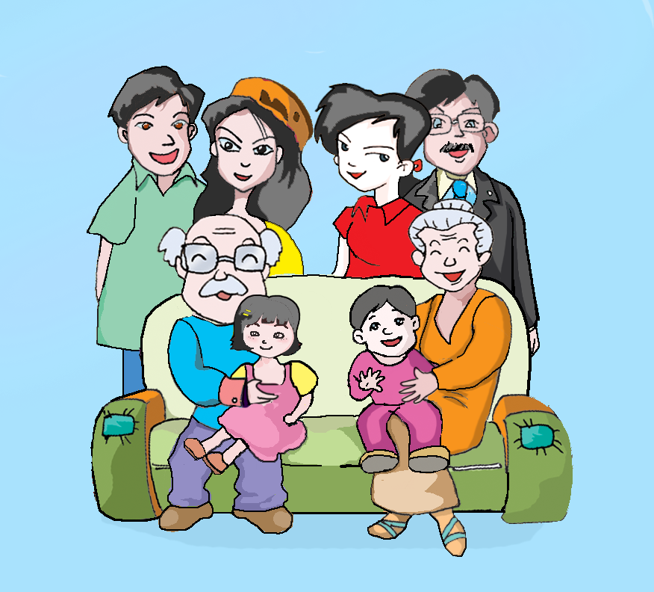
?
My father and my mother
Who am I?
It’s here.

Slide 5
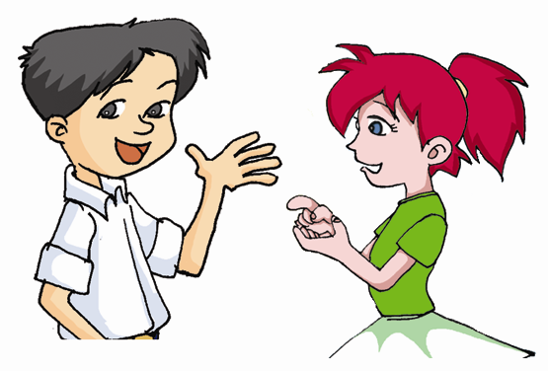
Look! This is a photo of my family.
Who’s the young woman in yellow?
She’s my aunt.
姨母
A Photo of Kangkang’s Family

Slide 6
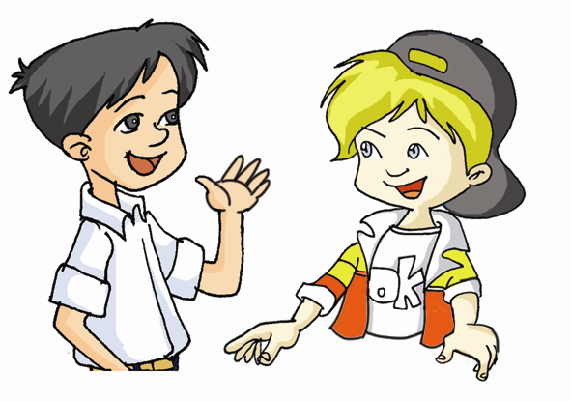
Is the young woman in red your mother?
Right. That’s my mother .
A Photo of Kangkang’s Family

Slide 7
Is the young man in a green T-shirt your uncle?
叔叔
Yes, he’s my uncle, my father’s brother.
A Photo of Kangkang’s Family
兄，弟

Slide 8
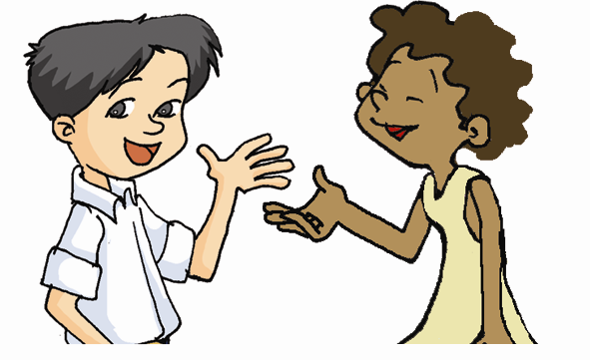
Who are they on the sofa?
沙发
My grandparents, my cousin and I.
You have a big family.
祖父母
堂兄弟，
表姊妹

Slide 9
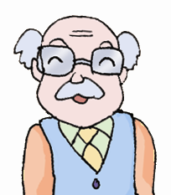
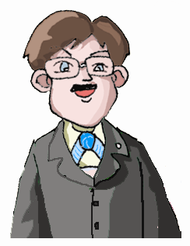
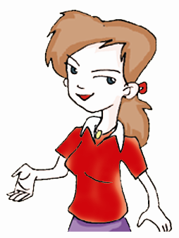
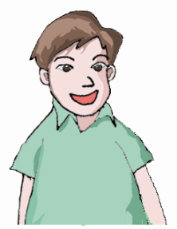
Kangkang's family tree
grandparents
mother
uncle
father
( )
( )
aunt
Kangkang (son)
( )
cousin

Slide 10
Exercise
This is a photo of Kangkang's ________. The young man in a green T-shirt is his _______. The young woman in yellow is his _____. They have a daughter and she is in pink. She is Kangkang’s
_______. The young woman in red and the young man in black are his ________. The old man and the old woman are Kangkang’s ____________ . Kangkang has a big family.
family
uncle
aunt
cousin
parents
grandparents

Slide 11
Group work
1.Talk about your family photo .
2.Give a report.
This is a photo of my family.
The young man in a green T-shirt is my …
The young woman in yellow is my …
The boy/girl is…
I love my family.

Slide 12
Let’s write.
This is a photo of my family.
The young man in a green T-shirt is my …He is a … The young woman in yellow is my …She is a … The boy/girl is me. I have a big family. I love my family.

Slide 13
Summary
1. Family members:
mother, father, parents, aunt,
uncle, brother, daughter, son …
2. Useful expression:
This is a photo of my family.

Slide 14
Brain storm
father
mother
son
aunt
parents
daughter
photo
brother
uncle
sister

Slide 15
Love
Love your mother and father
Love your brother and sister
Love everyone
And the world will become better(世界将会变得更美好）

Slide 16
Which group is the best?
A secret gift
(秘密礼物）

Slide 17
Let’s take family photo together! 让我们一起照全家福吧！

Slide 18
Homework
1.Write a passage about your family.
2.Read the new words.

Slide 19
Good-bye!

