Slide 1
Recycle 1
lesson 1
Unit One How can I get there?

Slide 2
学习目标
1、复习并掌握Unit1所学的单词和句子。
2、能正确描述场所的位置并准确指路。
3、完成课本中听录音画圈和填词的练习

Slide 3
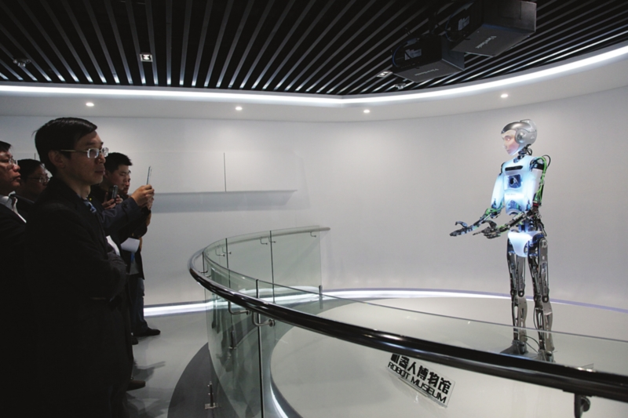
science museum
科学博物馆

Slide 4
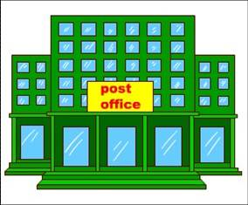
post office
邮局
Notes:
本资料来自于资源最齐全的２１世纪教育网www.21cnjy.com

Slide 5
bookstore
书店
Notes:
本资料来自于资源最齐全的２１世纪教育网www.21cnjy.com

Slide 6
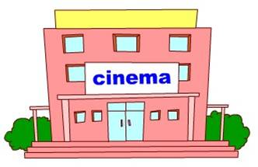
cinema
电影院
Notes:
本资料来自于资源最齐全的２１世纪教育网www.21cnjy.com

Slide 7
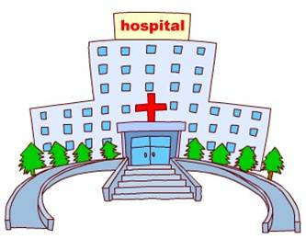
hospital
医院

Slide 8
Where can I go?

Slide 9
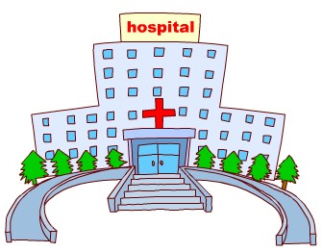
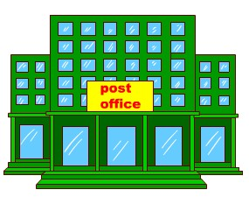
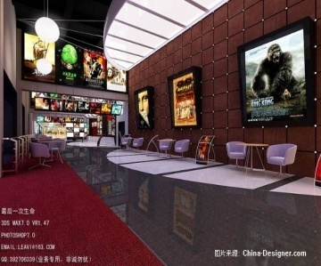
I can go to the…
I want to see a doctor.
I want to post a letter.
I want to see a film.
I want to buy a book.

Slide 10
表示场所的单词还有哪些呢？
我们一起来总结下吧！

Slide 11
park
library
supermarket
restaurant
bus station
shop
zoo

Slide 12
方位介词：
near beside in front of behind next to far from

Slide 13
turn right
go straight
turn left
crossing

Slide 14
问答句式：
Where is the +地点?
It is+方位词+地点.
How can I /we get there?
You can ...
注意：1.在建筑物、场所前用at.
2.在街道前用on.

Slide 15
Let’s guess
bookstore
Where is the________?

Slide 16
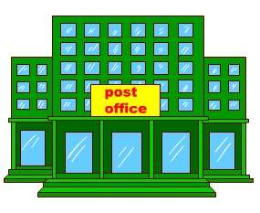
post office
It’s next to/near the __________.

Slide 17
Let’s guess
Where is the___________?
post office

Slide 18
It’s next to the
science museum .
It’s in front of the cinema.

Slide 19
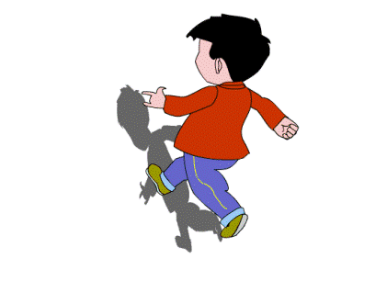
It’s in front of/behind
beside/near/next to
You can go straight/turn
Where’s the museum ?
How can I get...?
Library
Bookstore
Hospital
Park
Post office
Cinema
you

Slide 20
homework
1.Copy the words.
2. Make a dialogue about asking roads.

