Slide 1
Unit 4 Topic 1 When was it invented?
Section A

Slide 2
被动语态(Passive Voice ) be + done
English.
He speaks English.
He
English
him.
is spoken by
She
She speaks Chinese.
Chinese.
Chinese
is spoken by
her.
主动语态： 主语 + 动词 + 宾语
被动语态： 主语 + be + 过去分词 + by + 宾语

Slide 3
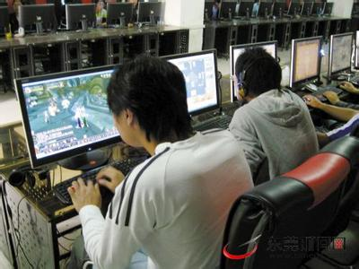
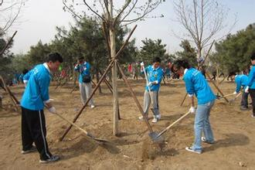
Many people use computers.
Computers _____ ________
by _______ _________.
are used
many people
The workers plant trees in the garden.
are planted
Trees _____ _______ in the
garden ____ the workers.
by
Can you try ？

Slide 4
Exercise
1. Trees __________ (water) in our school every
three days.
2. The zoo ___________ (visit) by lots of children
on weekends.
3. A Journey to West ________ (show) on CCTV
every summer.
4.On Christmas Day, children wake up early
and can’t wait ______ (open) the boxes of
presents.
5. We’ll have a chance _____ (see) the flower
show this weekend.
are watered
is visited
is shown
to open
to see

Slide 5
2 Follow the example to make up similar conversations.
lock/metal
n.锁 v.（用锁）锁上，被锁住
A: What’s the lock made of?
B: It’s made of metal.
A: What’s it used for?
B: It’s used for locking the door.
Notes:
PPT模板：www.1ppt.com/moban/ PPT素材：www.1ppt.com/sucai/
PPT背景：www.1ppt.com/beijing/ PPT图表：www.1ppt.com/tubiao/
PPT下载：www.1ppt.com/xiazai/ PPT教程： www.1ppt.com/powerpoint/
资料下载：www.1ppt.com/ziliao/ 范文下载：www.1ppt.com/fanwen/
试卷下载：www.1ppt.com/shiti/ 教案下载：www.1ppt.com/jiaoan/
PPT论坛：www.1ppt.cn PPT课件：www.1ppt.com/kejian/
语文课件：www.1ppt.com/kejian/yuwen/ 数学课件：www.1ppt.com/kejian/shuxue/
英语课件：www.1ppt.com/kejian/yingyu/ 美术课件：www.1ppt.com/kejian/meishu/
科学课件：www.1ppt.com/kejian/kexue/ 物理课件：www.1ppt.com/kejian/wuli/
化学课件：www.1ppt.com/kejian/huaxue/ 生物课件：www.1ppt.com/kejian/shengwu/
地理课件：www.1ppt.com/kejian/dili/ 历史课件：www.1ppt.com/kejian/lishi/

Slide 6
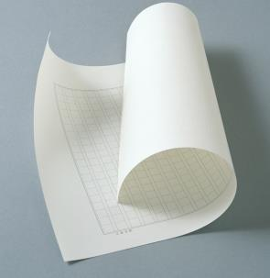
paper/wood
A: What’s the paper made from?
B: It’s made from wood.
A: What’s it used for?
B: It’s used for writing on.

Slide 7
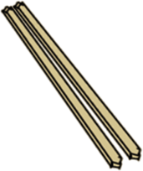
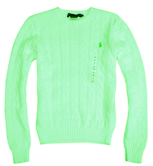
computer desk /wood
chopsticks/bamboo
watch/metal
sweater /cotton

Slide 8
be made of 由某种物质做成(看得出原材料，物理过程)
be made from 由某种物质制成(看不出原材料，化学过程)
be made up of 由几部分组成
be made in 在某地/某时制造
be made by 由某人制造
be made into 被制成
1
2
Language points

Slide 9
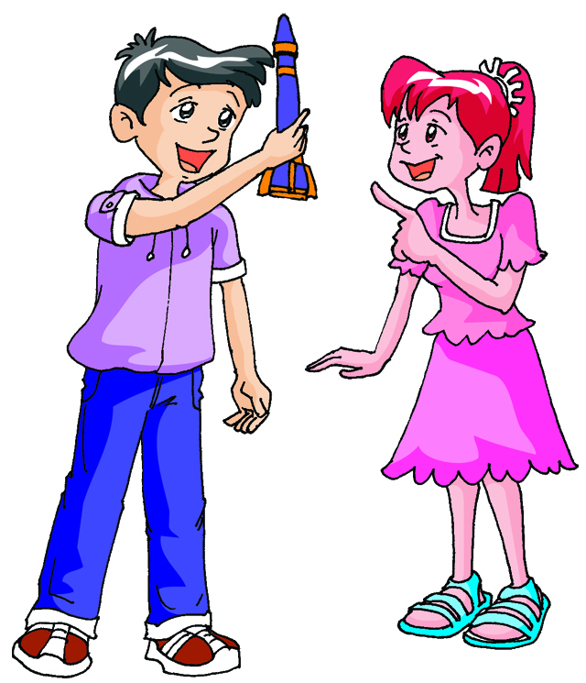
1a Listen, look and say.
Wow !A model rocket !
A. What’s it made of?
B. It’s made of metal.
A. Do you know what it is used for?
B. It’s used for sending satellites
or spaceships into space.

Slide 10
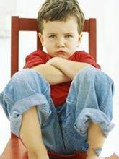
Why is Jane unhappy?
Because Jane was not allowed to play computer games last night.
allow v. 允许
1. allow sb. to do sth.
允许某人做某事
2. allow doing sth.
允许做某事
3. be allowed to do sth.
被允许做某事

Slide 11
Let’s sum up together.
聚焦一般过去时的被动语态
结构:助动词(was/were)+及物动词的过去分词
1.肯定句式 ：主语+was /were+v.-ed
2.否定句式 ：主语+was/were + not+v.-ed
3.一般疑问句式： Was /Were+主语+vt.-ed
4.特殊疑问句式：疑问词W/H+was/were+主语+v.-ed
E.g. An e-mail was sent to her friend by Jane yesterday.
An e-mail wasn’t sent to her friend by Jane yesterday.
Was an e-mail sent to her friend by Jane yesterday?
Who was the e-mail sent to by Jane yesterday?

Slide 12
1b Listen to 1a and mark T (True) or F (False).
Jane is unhappy because she was not allowed to go to a party last night.( )
Kangkang’s father made a model rocket for him. ( )
The rocket is made of metal. ( )
A rocket is used for sending satellites or spaceships into space. ( )
F
F
T
T

Slide 13
1a Listen , look and say
动画1a

Slide 14
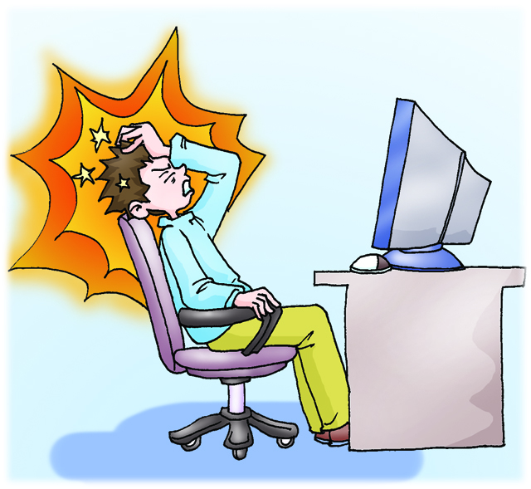
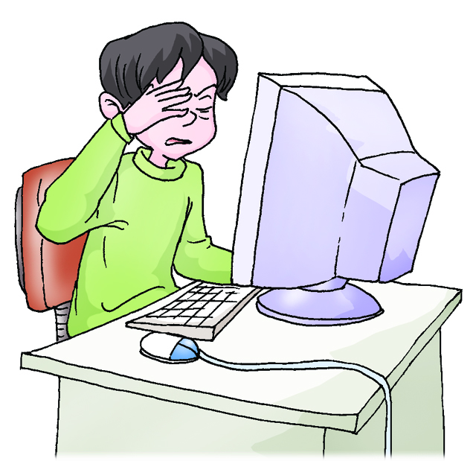
1c Read 1a and answer the following questions.
1. Why did Kankang ask Jane not to spend too much time on computer games ?
It’s bad for her health if she spends too much time on them.
too tired
headache
sore eyes

Slide 15
2. What’s a rocket used for?
It’s used for sending satellites or spaceships into space .
be used for 被用来做
be used to do 被用来做
be used as 被用作
used to do sth. 过去常做
be used to doing sth. 习惯于做

Slide 16
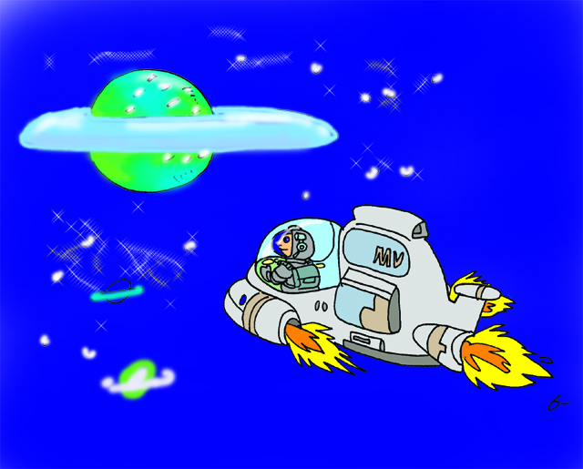
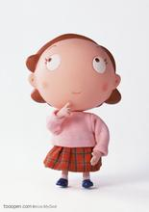
3. Who taught Kangkang some knowledge about spaceships?
Mr. Brown.
4. What’s Kangkang’s dream?
He wishes he could go into space some day.
some day----某一天，总有一天(将来)
e.g. I wish I could have my own house some day.
I hope his dream will come true .
come true----变成真的,实现
realize/achieve---make sth. come true

Slide 17
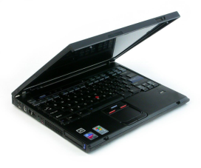
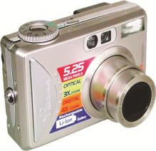
3a A. Listen to the conversations and number the following pictures.
2
3
1

Slide 18
3a B. Listen again and complete the table .
Invention Item | laptop | cell phone | digital camera
Material
Usage
Year
country
plastic
metal and plastic
plastic
study, work and play
communicate
take photos
around 1985
1973
around 1975
Japan
America
America

Slide 19
3b Work in pairs. Ask and answer questions based on the table in 3a with passive voice.
Example:
Focus on the meaning in communication. Don’t be afraid of making mistakes.
A: What is a laptop made of?
B: It is made of plastic.
A: What’s it used for?
B: It is used for studying.
A: When and where was it developed?
B: It was developed in Japan in 1985.

Slide 20
Exercises
Change the following sentences.
1.My mother allows me to use her cellphone.(改为被动语态)
I _____ ______ _____ use my mother’s cellphone.
2.A rocket is used for launching satellites and spaceships.
(就画线部分提问)
____ ___ a rocket ___ ___?
3.The digital camera was invented in 1975. (就划线部分提问)
____ ____ the digital camera _______ ?
4. Maybe he is an inventor. (改为同义句)
He ____ ____ an inventor.
am allowed to
What is
used for
When was
invented
may be

Slide 21
Summary
We learn: 1.Some words: lock, rocket, metal, satellite,
spaceship
2. Some phrases: be made of, be used of,
some day, come true
3. Some sentences:
(1) I wish I could go into space some day.
(2) I hope your dream will come true.
(3) -What is a rocket used for?
-It’s used for sending satellites or
spaceships into space.
We can: Use the passive voice.

Slide 22
Assignment
Read 1a.
Memorize the useful expressions and key sentences that we learn today.
Finish Section A in your workbook.
Preview Section B.

