Slide 1
Unit 3 My friends
A. Let’s learn

Slide 2
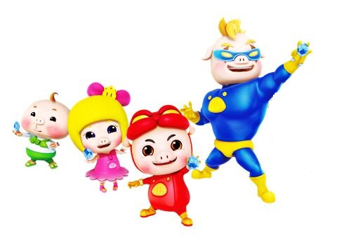
tall
thin
short
fat
strong
强壮的

Slide 3
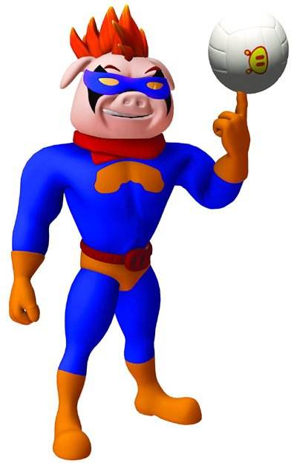
tall
strong
Chao Renqiang is _______and ________.

Slide 4
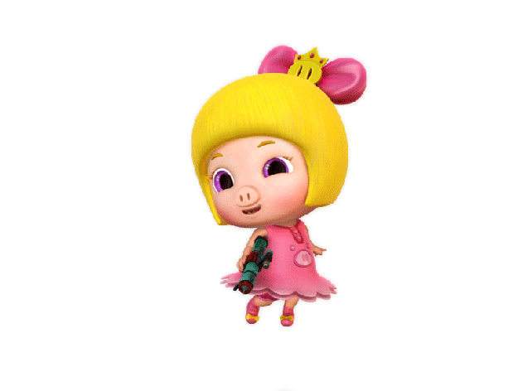
short
thin
Fei Fei is _______ and ________.

Slide 5
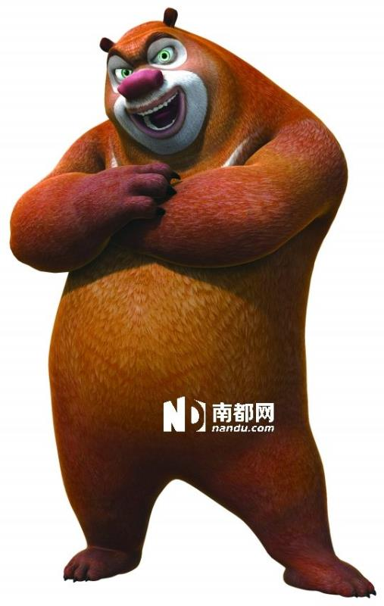
Who is he?
He is ______.
His name is______.
他的
He’s ______ and ______.
tall
short
strong
thin

Slide 6
Who is he?
His name is______.
He’s ______ and
______.
tall short fat thin...

Slide 7
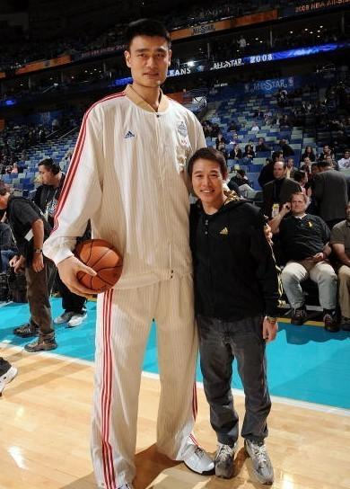
姚明
Who is he?
His name is______.
tall
strong
He’s _____and ______.
tall short strong thin

Slide 8
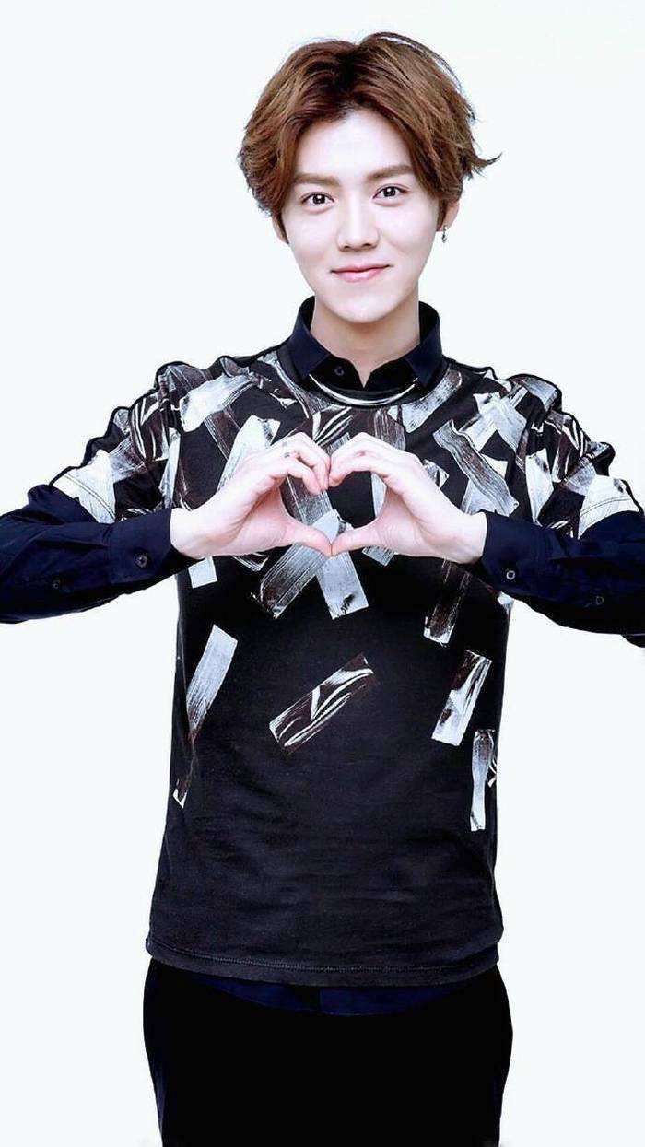
鹿晗
Who is he?
His name is______.
He’s ______ and ______.
tall short fat thin...

Slide 9
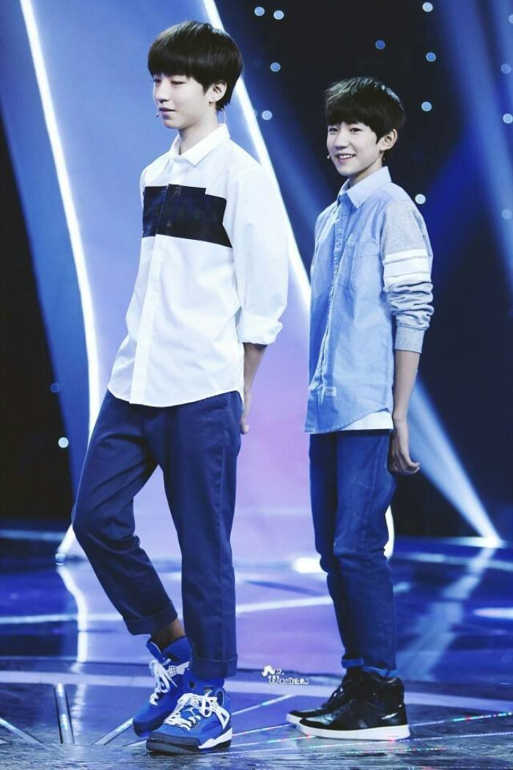
tall
strong
short
thin

Slide 10
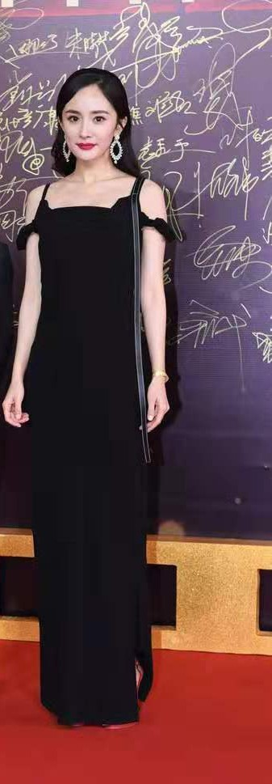
杨幂
Who is ____? A. he B. she
she
Her name is______.
她的
She’s _____and ____.
tall short fat thin...

Slide 11
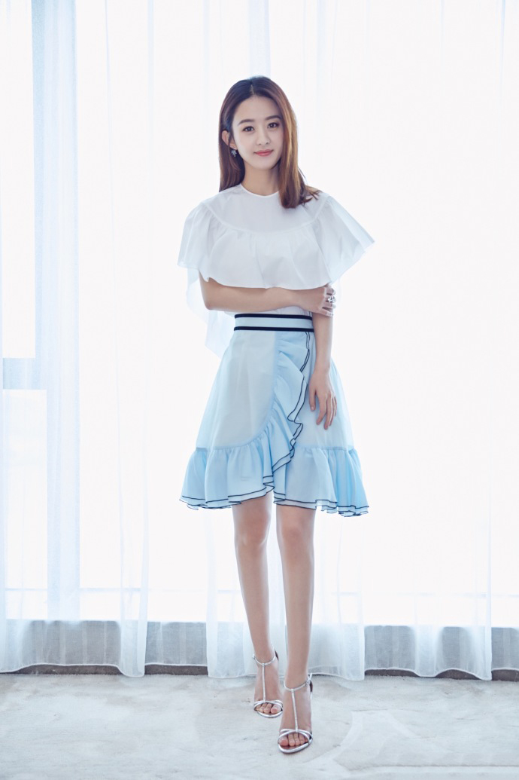
赵丽颖
Who is she?
Her name is______.
tall
thin
She’s ______ and ______.
tall short fat thin...

Slide 12
Who is she ?
Her name is______.
thin
She’s ______ and ______.
tall
tall short fat thin...

Slide 13
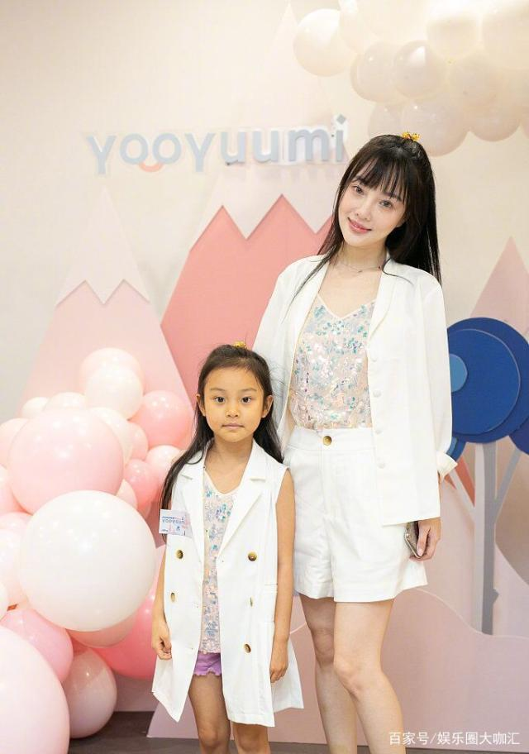
李
小
璐
甜心

Slide 14
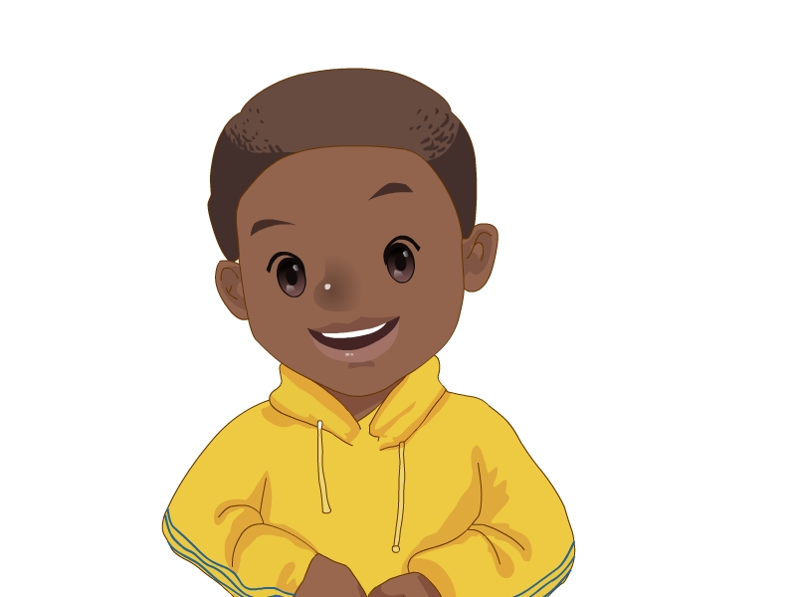
I have a good friend.
我有一位好朋友。

Slide 15
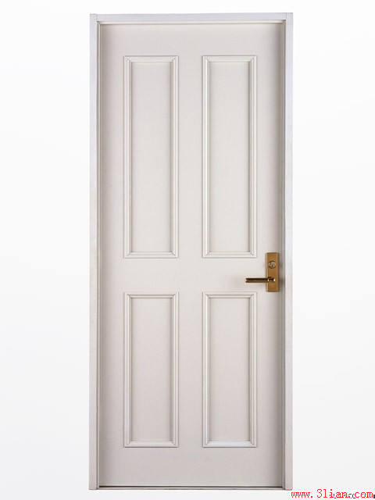
I have a good friend.
He’s tall and strong.
His name is _____.

Slide 16
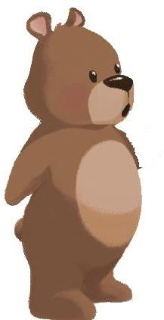
His name is ____.

Slide 17
I have a good friend.
He’s short and thin.
His name is _____.

Slide 18
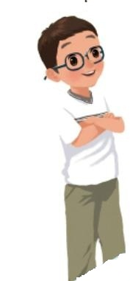
His name is ____.

Slide 19
I have a good friend.
She’s friendly .
友好的

Slide 20
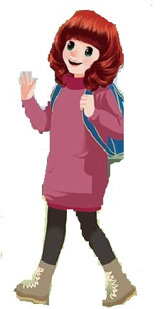
friendly
友好的
Her name is _____.

Slide 21
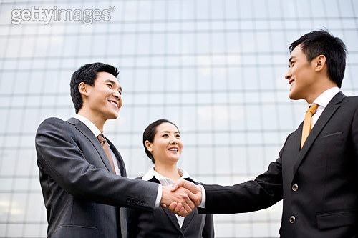
She’s friendly .
He’s friendly .
They’re friendly .

Slide 22
I have a good friend.
She’s quiet .
文静的
Her name is _____.

Slide 23
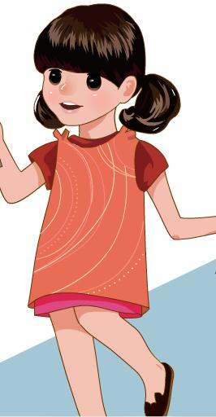
Her name is _____.

Slide 24
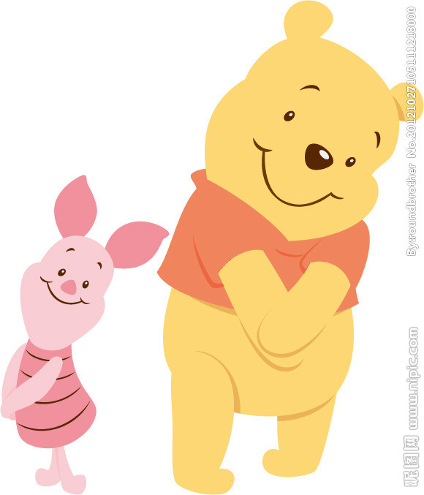
quiet
安静的
文静的

Slide 26
friendly
quiet
short and thin
tall and strong

Slide 27
Talk about your friends with your partner.
(和你的同桌讨论一下你的朋友）
My friend
I have a good friend.
Her /his name is
She’s/He’s
She’s/He’s

Slide 29
A friend in need is a friend indeed.
共患难的朋友才是真朋友。
A life without a friend is a life without a sun.
A life without a friend is a life without a sun.
人生在世无朋友，犹如生活无太阳。
人生在世无朋友，犹如生活无太阳。

Slide 30
Homework
Describe your good friend to your family. 向你的家人描述你的好朋友
A life without a friend is a life without a sun.
A life without a friend is a life without a sun.
人生在世无朋友，犹如生活无太阳。
人生在世无朋友，犹如生活无太阳。

Slide 31
Thank you !

